Slide 1


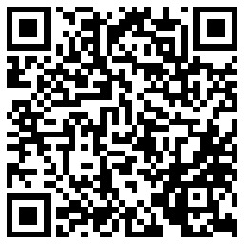
54th NCDA Annual Conference June 13-15, 2023 Orlando, FL
HOME – Housing Strategies That Work
Darwin M. Wade, MBA, MPA, CPM
Assistant Director (I)
City of Dallas, Texas
Housing & Neighborhood Revitalization
Darwin.Wade@Dallas.gov
O: 214-670-3906 C: 469-404-6891

Slide 2
Dallas, TX by the Numbers
Population: 1.3 million
Median family income: $105,600
80% AMI for family of four: $82,500
% Low Mod: 52.8%
Poverty rate: 17.7%
Owner-occupied housing: 41%
Renter-occupied housing 59%
Median home price: $405,000
Median gross rent: $1,178
Max HOME sales price: $271,000
Source: 2021 ACS 5-Year Data and HUD Exchange
Notes:
Median family income = $97,400
80% AMI for a family of four = $77,900
Population = 1,288,457
Poverty rate = 17.7%
Median household income = $58,231
% low mod = 52.8%

Slide 3
FY 2023-24 HUD Entitlements
Community Development Block Grant (CDBG) | $15,009,603
HOME Investment Partnerships | $6,933,179
Emergency Solutions Grant (ESG) | $1,241,010
Housing Opportunities for Persons With AIDS (HOPWA) | $9,604,613
TOTAL | $32,788,405
CDBG – Housing Activities
Home Improvement and Preservation Program (HIPP) | $4,281,465
Residential Development Acquisition Loan Program | $2,638,224
Dallas Homebuyer Assistance Program | $400,000
TOTAL | $7,319,689
FY 2022-23 Affordable Housing Development HOME Funds
HOME Housing Development Loan Program | $4,277,307
CHDO Development Loan Program | $1,216,076
Dallas Homebuyer Assistance Program | $400,000
TOTAL | $5,893,383

Slide 4
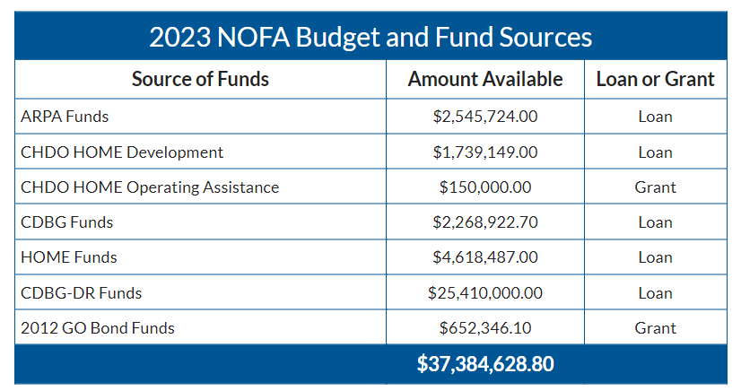
Development NOFA
Standing NOFA provides gap financing to for-profit, non-profit developers proposing development of affordable rental, for-sale, and housing for persons experiencing homelessness
Notes:
NOFA is open to for-profit and non-profit applicants proposing the development of affordable rental and for-sale housing developments, including affordable rental housing for individuals and families experiencing homelessness, that also include a portion of units for persons with special needs

Slide 5
HOME Regulations
Created by the National Affordable Housing Act of 1990 (NAHA)
HOME regs can be found in 24 CFR Part 92 and HUD Exchange
Congressional Intent:
  Provide decent affordable housing to lower-income households;
  Expand the capacity of nonprofit housing providers;
  Strengthen the ability of state and local governments to provide housing; and
  Leverage private-sector participation

Slide 6
HOME Eligible Activity Types
Homeowner Rehabilitation
Homebuyer Activities
  Direct assistance to homebuyers
  Homebuyer housing development projects
Rental Housing Activities
Tenant-Based Rental Assistance (TBRA)

Slide 7
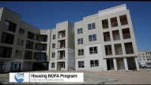
Westmoreland Station

Slide 8
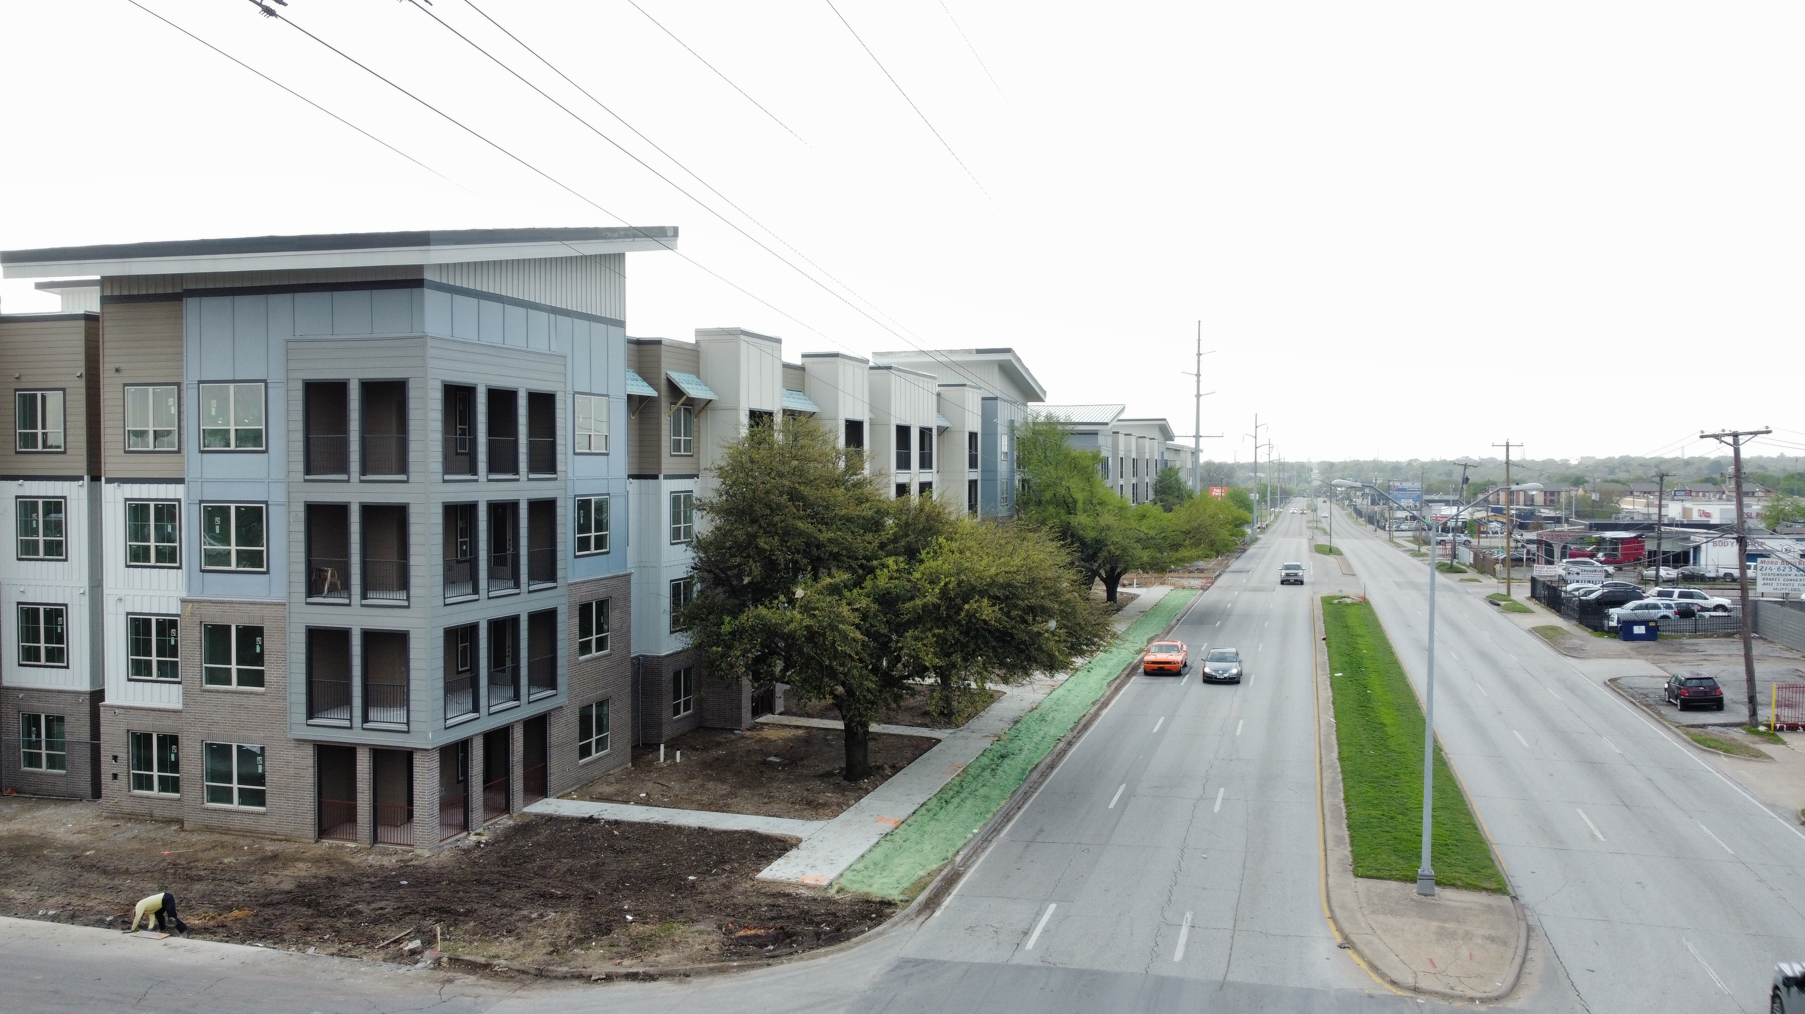
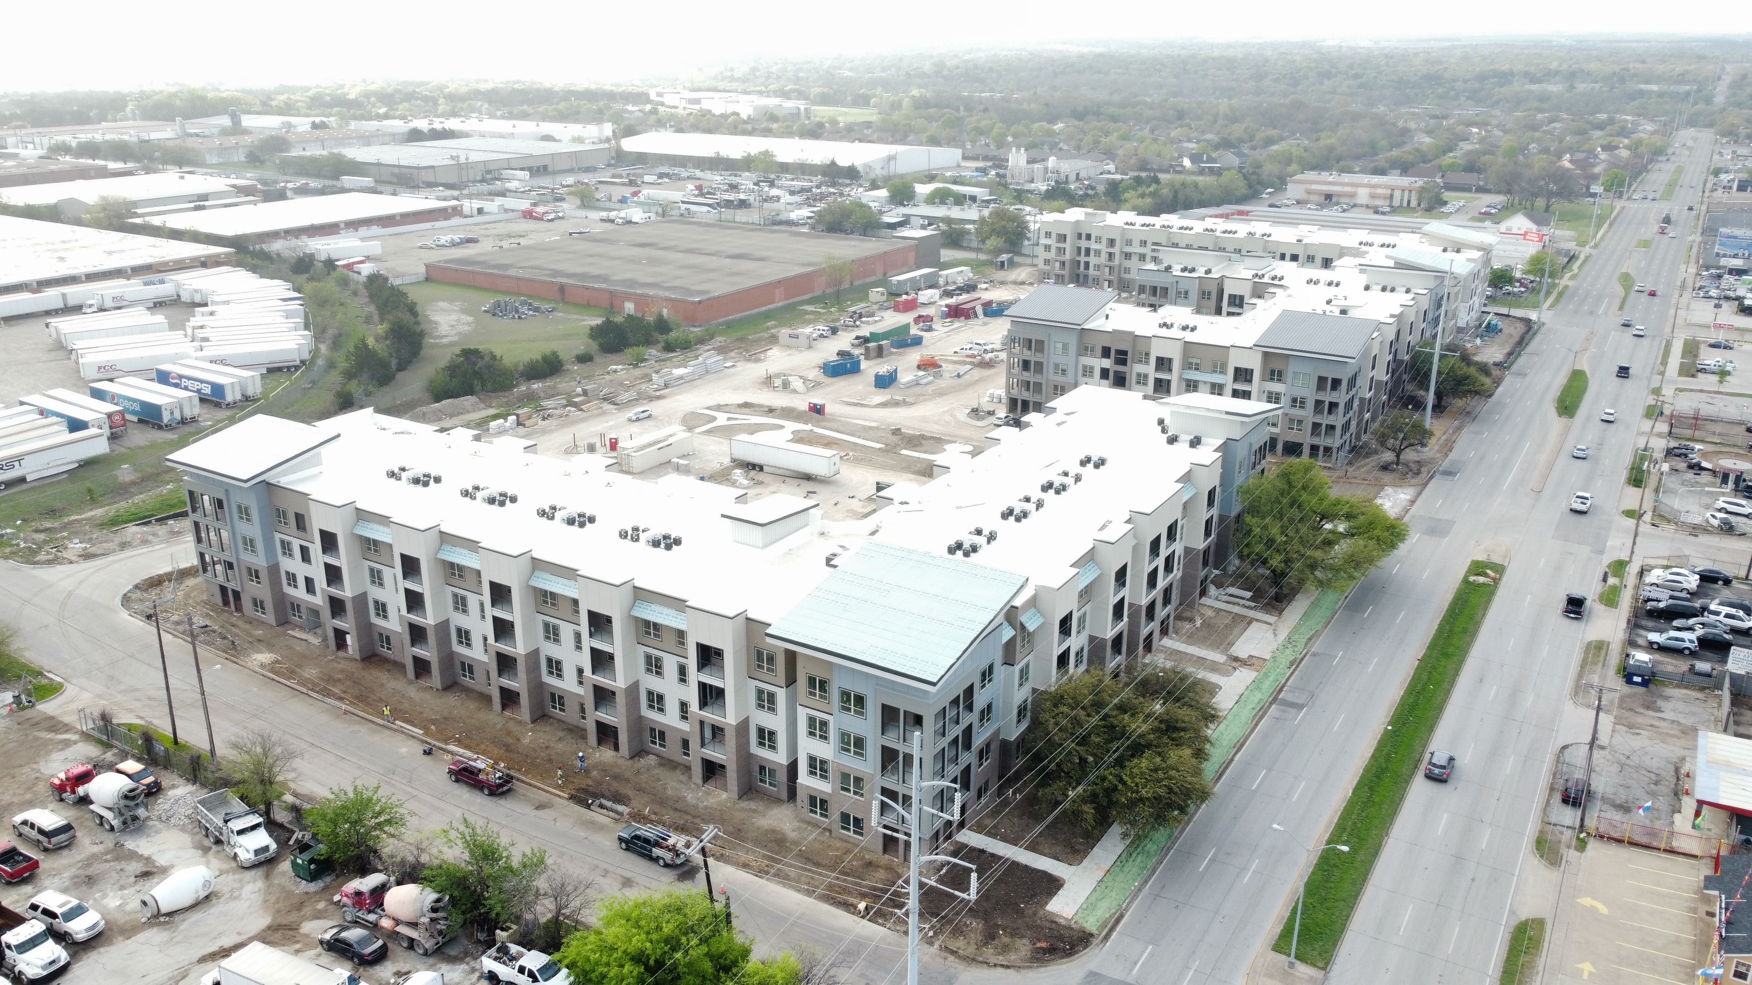
Westmoreland Station

Slide 9
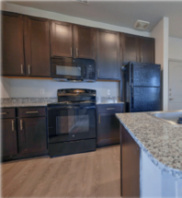
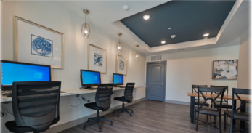
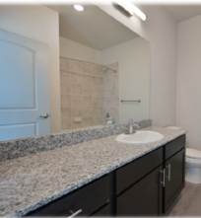
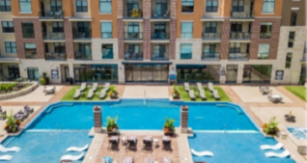
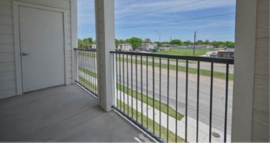
Westmoreland Station

Slide 10
Project Overview
248-unit Class “A” mixed income development
223 of the 248 units are affordable to households at/or below 80% AMI
24 floating High HOME and 7 LOW HOME-assisted units
Flagship Transit-Oriented Development (TOD)
Located on 7.2 acres at SE corner of Westmoreland Road and Glenfield Avenue
Provides residents with direct access to Dallas Area Rapid Transit (DART) light rail, without the need to cross major thoroughfare
Comprised of one, two-, and three-bedroom floorplans serving income bands of 50% and 60% AMI and market-rate.
Unit Amenities: Open-concept, granite countertops, faux-wood flooring, nine-foot ceilings, personal balconies, walk-in closets
Common Amenities: Resort-style pool, fitness center, community room, dog park, outdoor plaza, business center, secured entrances, and covered entries
Notes:
90% of unit will serve families 50-60 AMI
59 – 1-brd sqft 729
139 2-brd sqft 1021-1164
50 3-brd sqft 1326
90% of unit will serve families 50-60 AMI
Generation Housing Partners worked creatively with the City of Dallas
to fulfill one of its largest needs: affordable, accessible, and transit-oriented
housing.
By providing direct access to the
Westmoreland Station, residents of Westmoreland Station benefit
from inexpensive, accessible, and dependable transportation, year-round.
Ground floor stoops with personal sidewalk access will be
provided along the main corridor, Westmoreland Rd, further
enhancing the walkability and transit-oriented focus of the
development.

Slide 11
City of Dallas Participation
Invested CDBG and HOME dollars
  CDBG: $ 3,000,000
  HOME: $ 5,000,000
  Total: $ 8,000,000
Funds awarded through Housing Department’s Standing Notice of Funding Availability (NOFA)
Dallas Housing Finance Corporation (DHFC) entered in agreement with City to purchase land and leased land to developer through long-term ground lease
Remaining balance was funded using 4% low-income housing tax credits and private capital
Total Development Cost = $59.4 Million

Slide 12
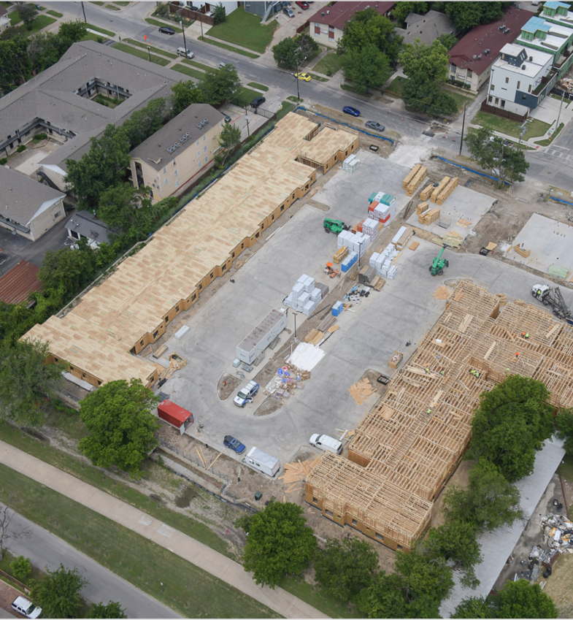
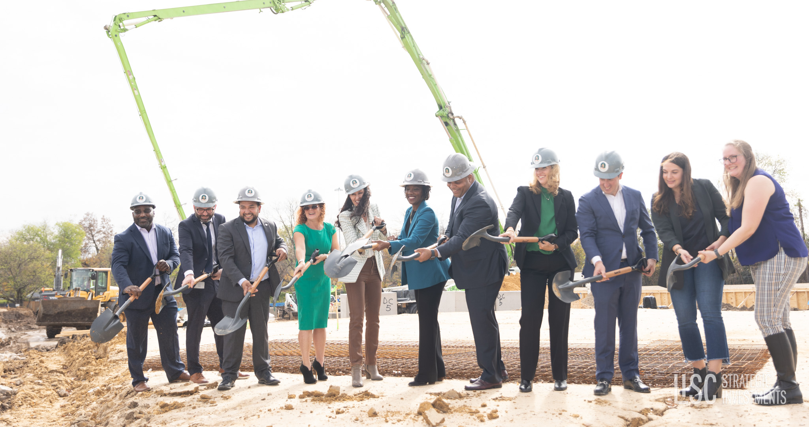
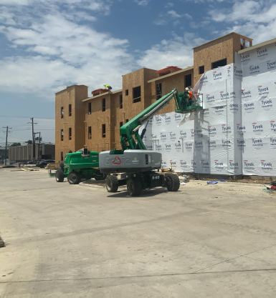
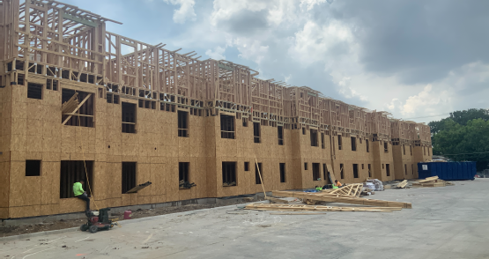
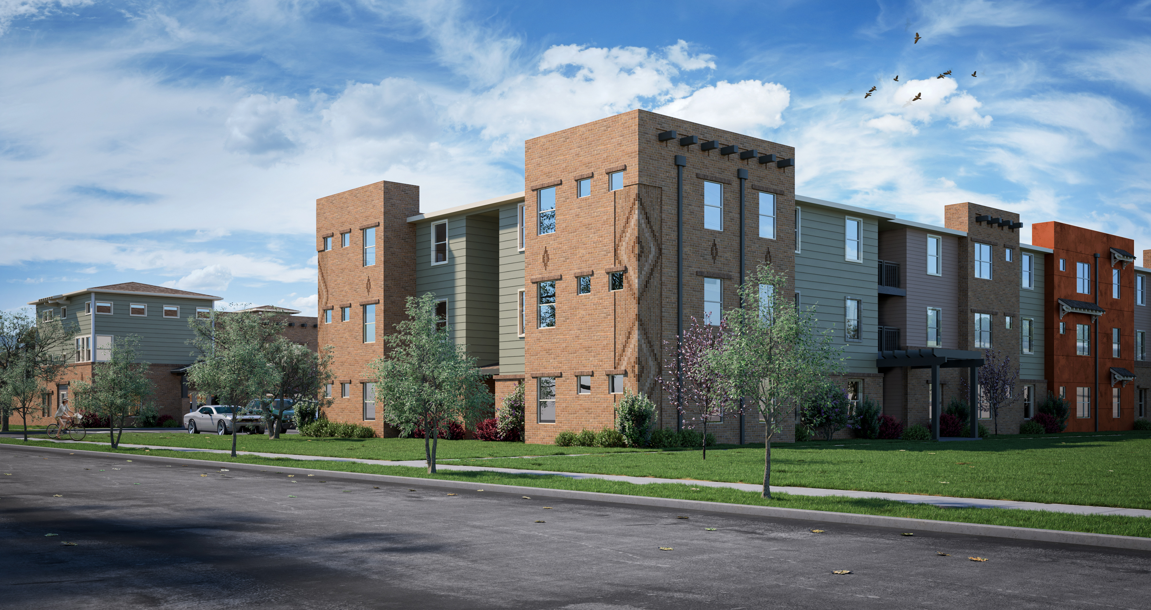
Kiva East

Slide 13
Project Overview
87-unit Class “A” mixed income development
70 of the 87 units are affordable to households at/or below 80% AMI and 17 non-income restricted units
8 floating High HOME and 3 LOW HOME-assisted units
Located on 2.5 acres at 4724 & 4806 East Side Avenue
Comprised of one, two-, and three-bedroom floorplans serving income bands of 50% and 60% AMI and market-rate.
Unit Amenities: High efficiency appliances and lighting, granite countertops, resilient hard surface floor, kitchen tile backsplash, tile tub surrounds
Common Amenities: Resort-style pool, community room, fitness center, dog park, outdoor plaza, business center, secured entrances, and resident services

Slide 14
City of Dallas Participation
Invested HOME dollars
  HOME: $ 2,500,000
Funds awarded through Housing Department’s Standing Notice of Funding Availability (NOFA)
Remaining balance was funded using 9% low-income housing tax credits and private capital
Total Development Cost = $22.7 Million

Slide 15

54th NCDA Annual Conference June 13-15, 2023 Orlando, FL
Questions?
Darwin M. Wade, MBA, MPA, CPM
Assistant Director (I)
City of Dallas, Texas
Housing & Neighborhood Revitalization
Darwin.Wade@Dallas.gov
O: 214-670-3906 C: 469-404-6891

